Slide 1
Employee salary prediction
CAPSTONE PROJECT
Presented By: Ujjwal Bhardwaj
College : University of Allahabad (MCA)

Slide 2
OUTLINE
Problem Statement
System Development Approach (Technology Used)
Algorithm & Deployment
Result
Conclusion
Future Scope(Optonal)
References

Slide 3
Problem Statement
Predict employee salaries based on features such as:
Education level , Experience, age , industry , job role, location
Goal: Help HR teams make data-driven decisions in recruitment and compensation planning.
Why? Manual salary decisions can be biased or inconsistent. ML can offer consistency and insights

Slide 4
System Approach
Languages: Python
Libraries :
Pandas , numpy (data handling)
Matplotlib, seaborn (data visualization)
Scikit-learn (model building)
Tools : Jupyter Notebook / Google Colab
ML Algorithms Tried: Linear Regression, Decision Tree, Random Forest
Data Source: CSV dataset with employee records

Slide 5
Algorithm & Deployment
Data Collection
Uses adult.csv with employee details.
Data Preprocessing
Handling missing values, encoding categorical data
Exploratory Data Analysis (EDA)
Correlation heatmap, outlier detection
Data Encoding and Feature Selection
Removed irrelevant columns, selected best predictors
Model Building
Tried multiple algorithms (e.g., Linear Regression, Random Forest)
Model Evaluation
Used metrics like MAE, RMSE, and R² Score
Deployment
Created a simple Streamlit app to input new data and predict salary

Slide 6
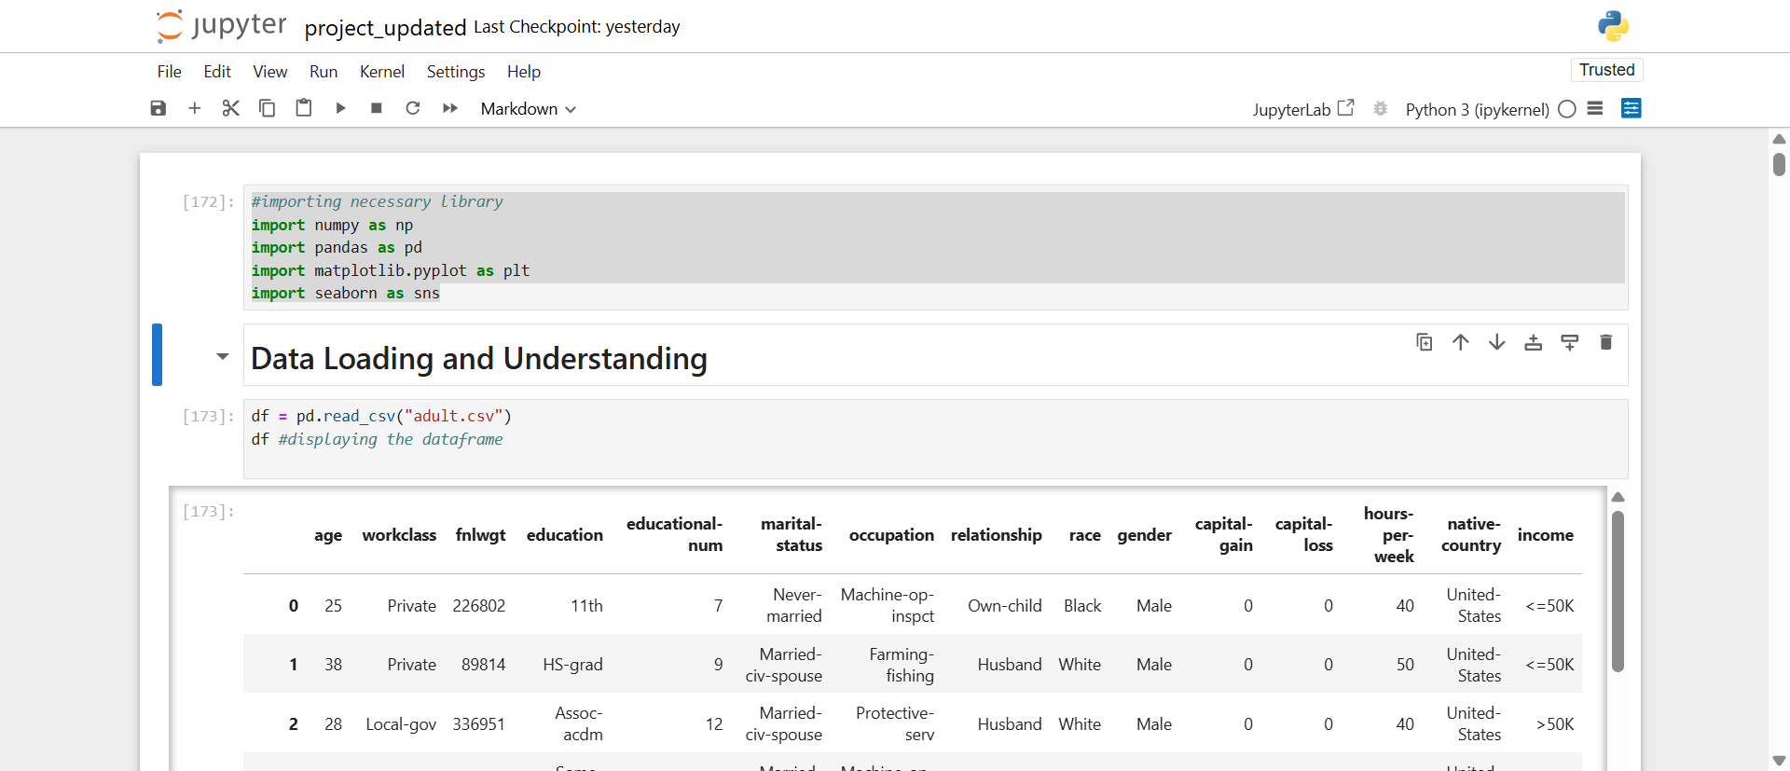
1. Data collection

Slide 7
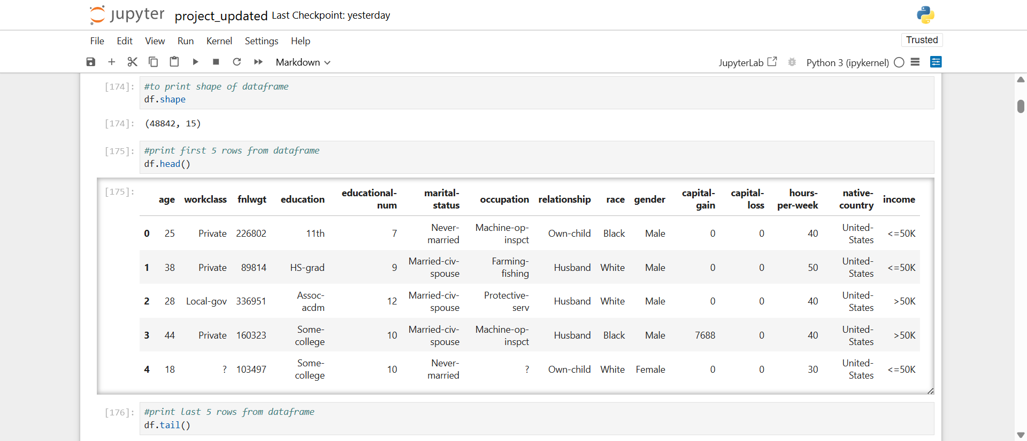
2. Data preprocessing

Slide 8
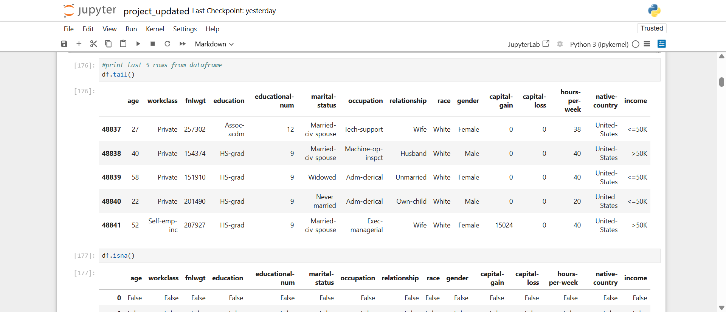

Slide 9
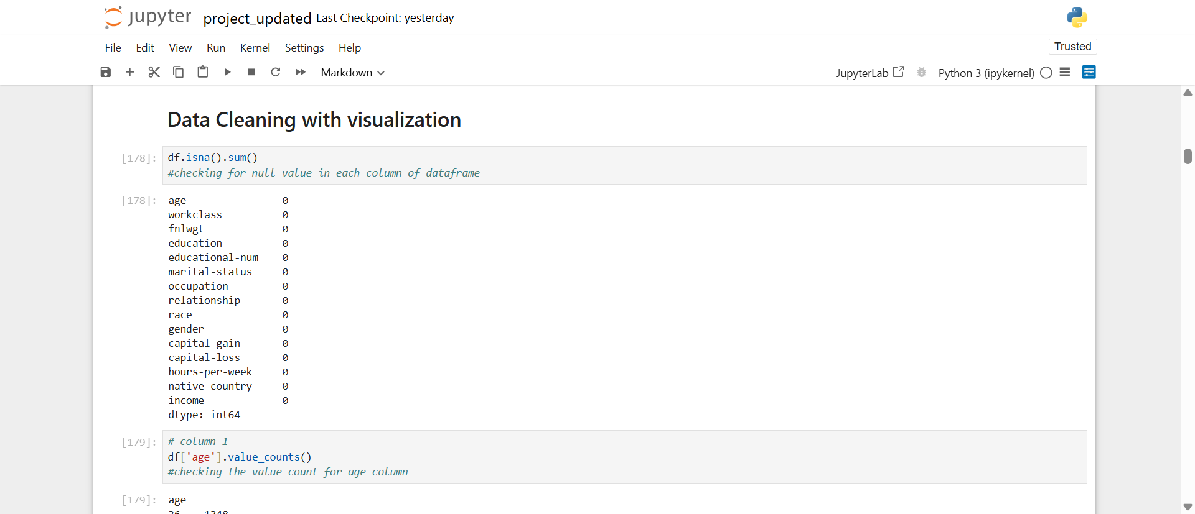

Slide 10
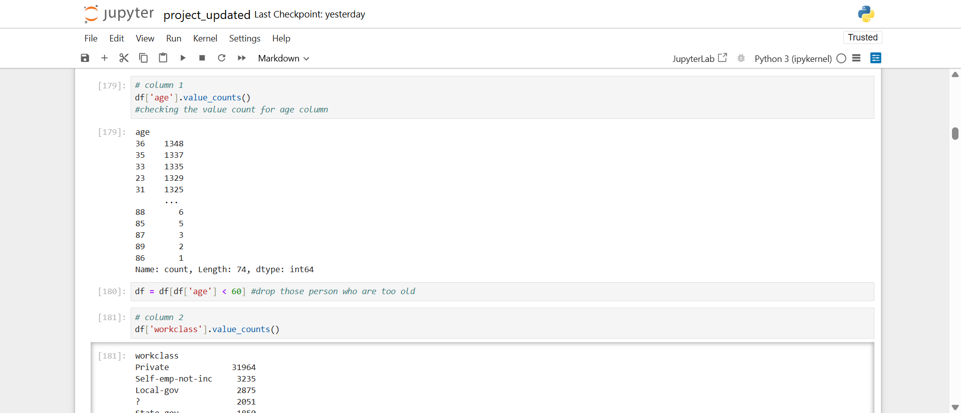

Slide 11
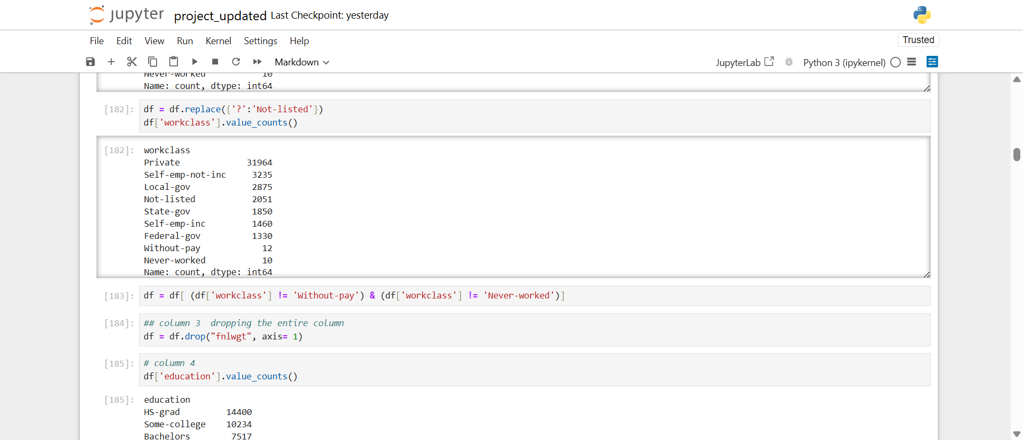

Slide 12
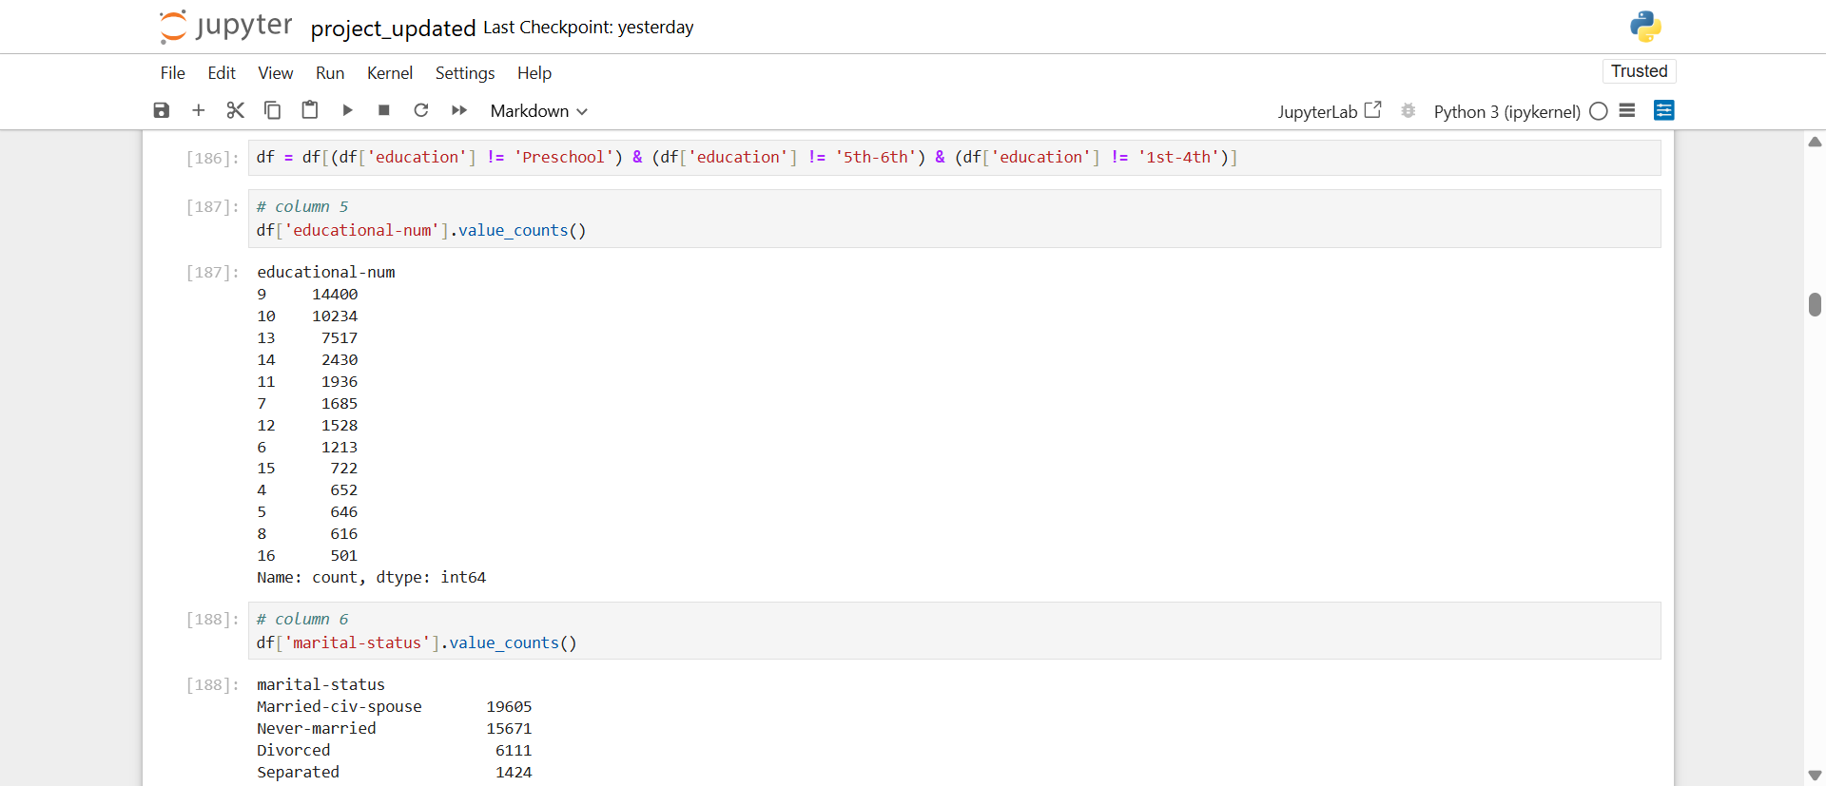

Slide 13
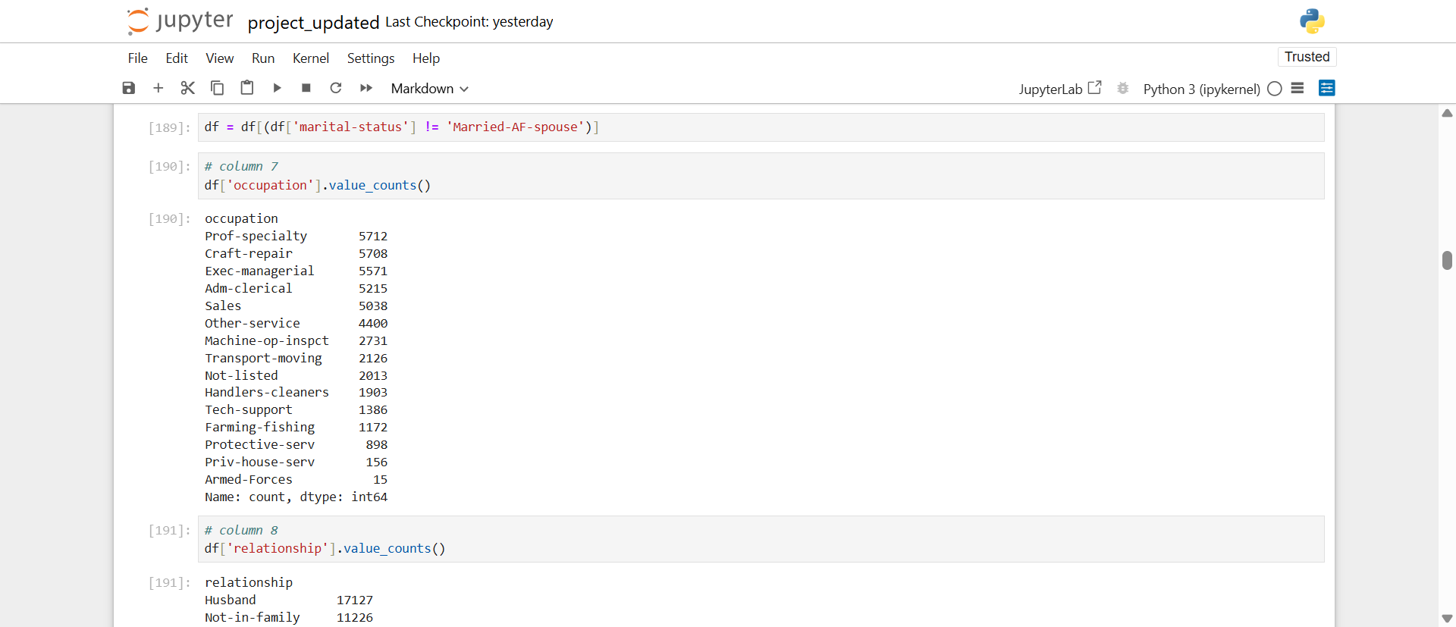

Slide 14
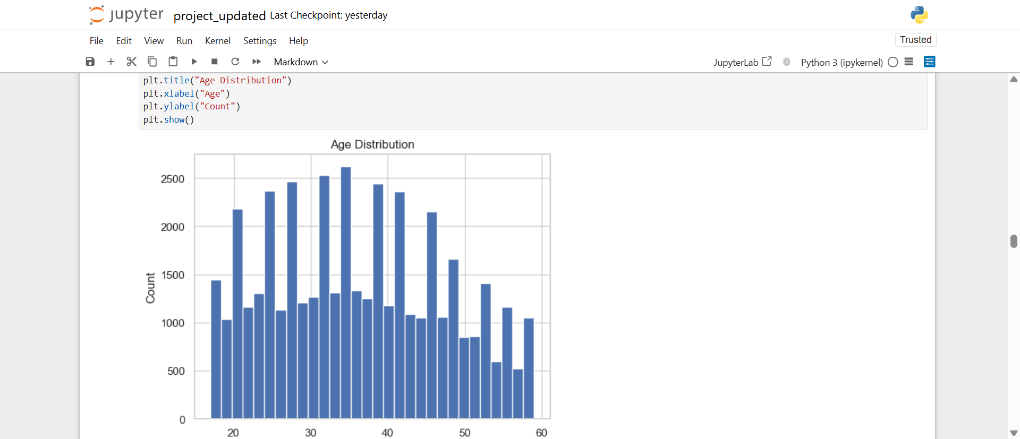
3. Exploratory data analysis (EDA)

Slide 15
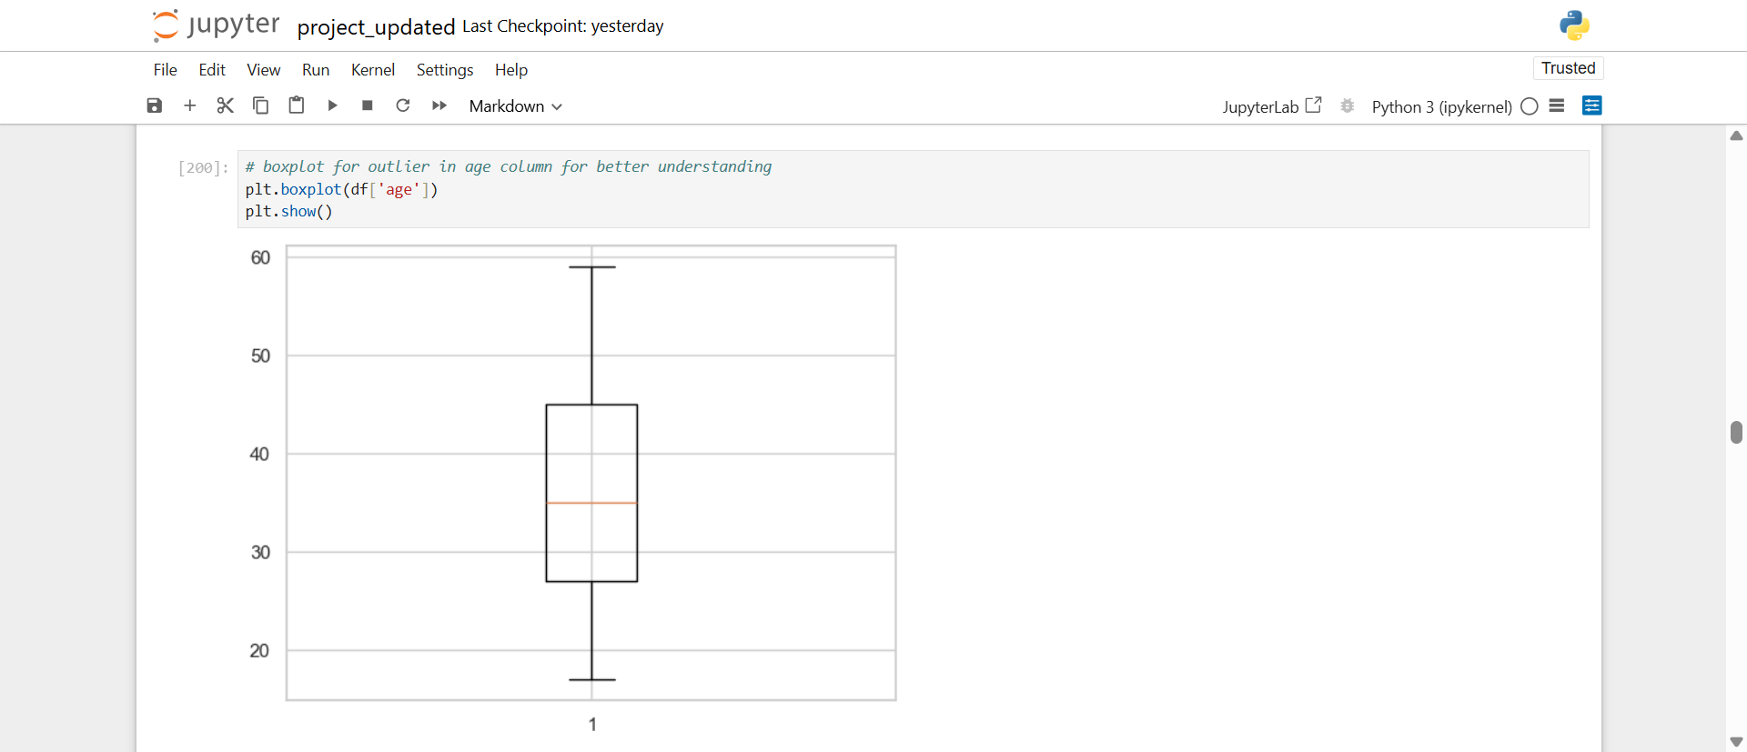

Slide 16
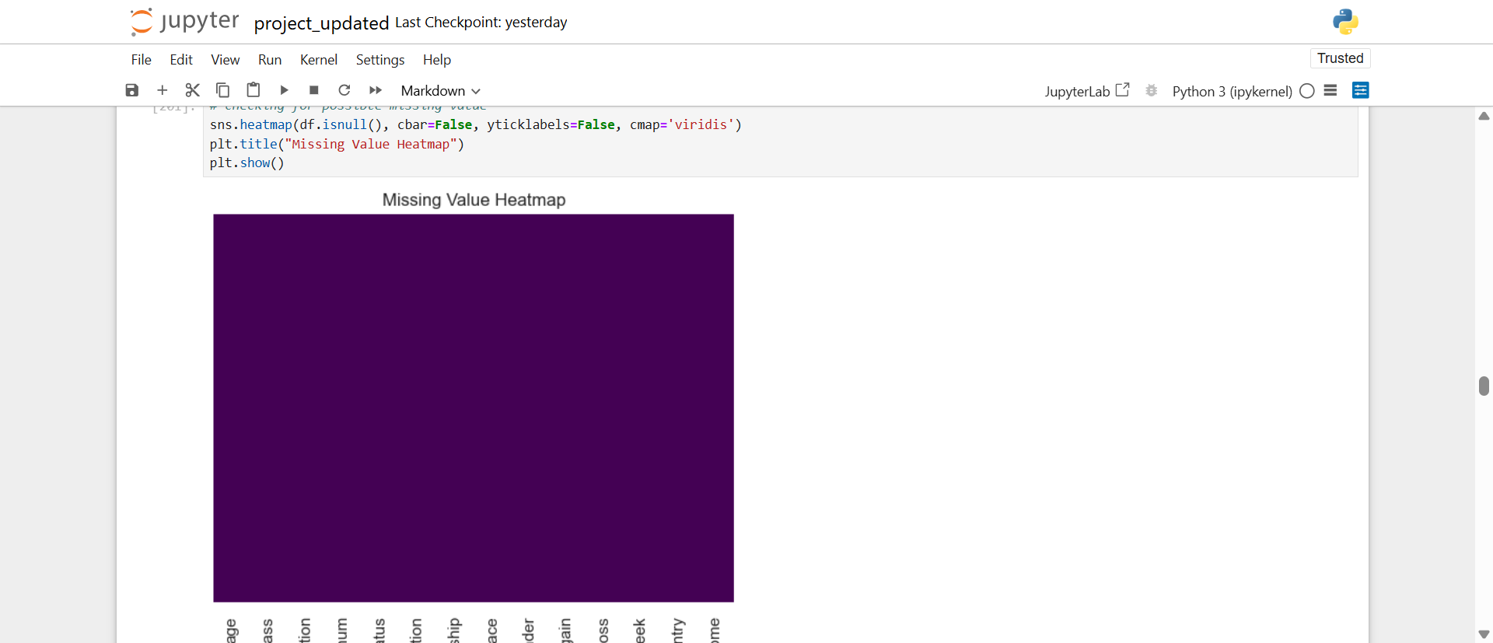

Slide 17
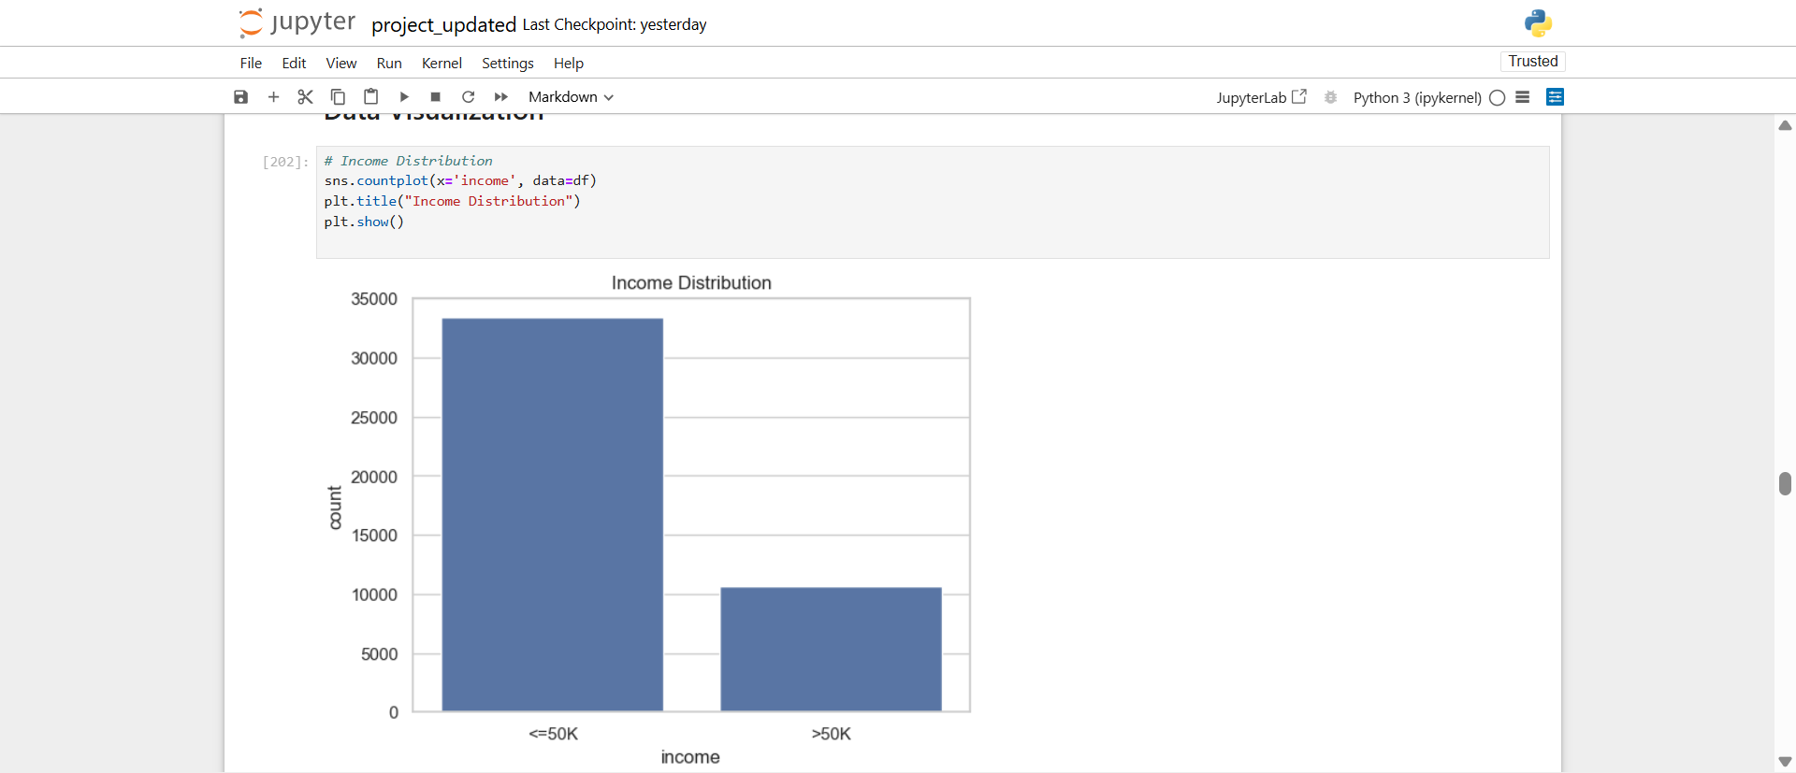

Slide 18
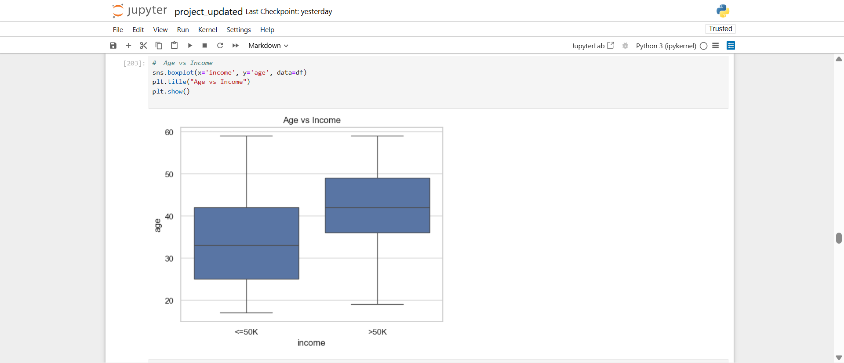

Slide 19
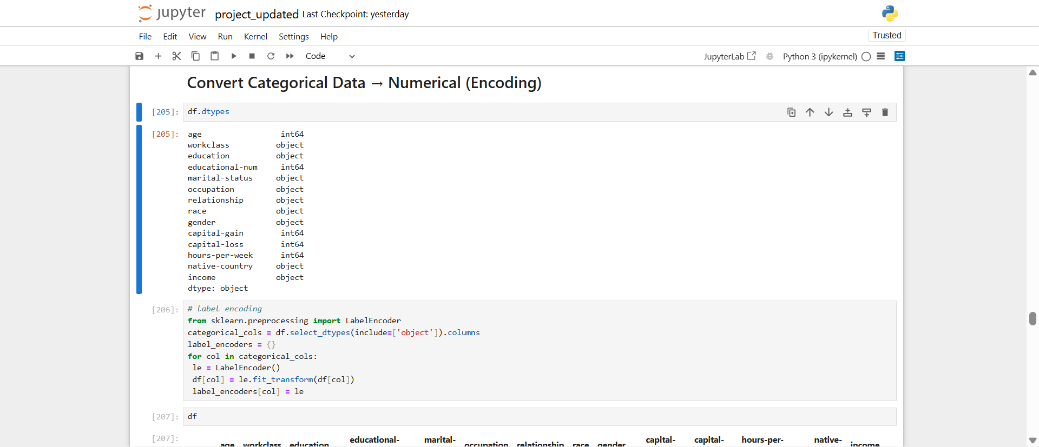
4. Converting categorical data to numerical encoding

Slide 20
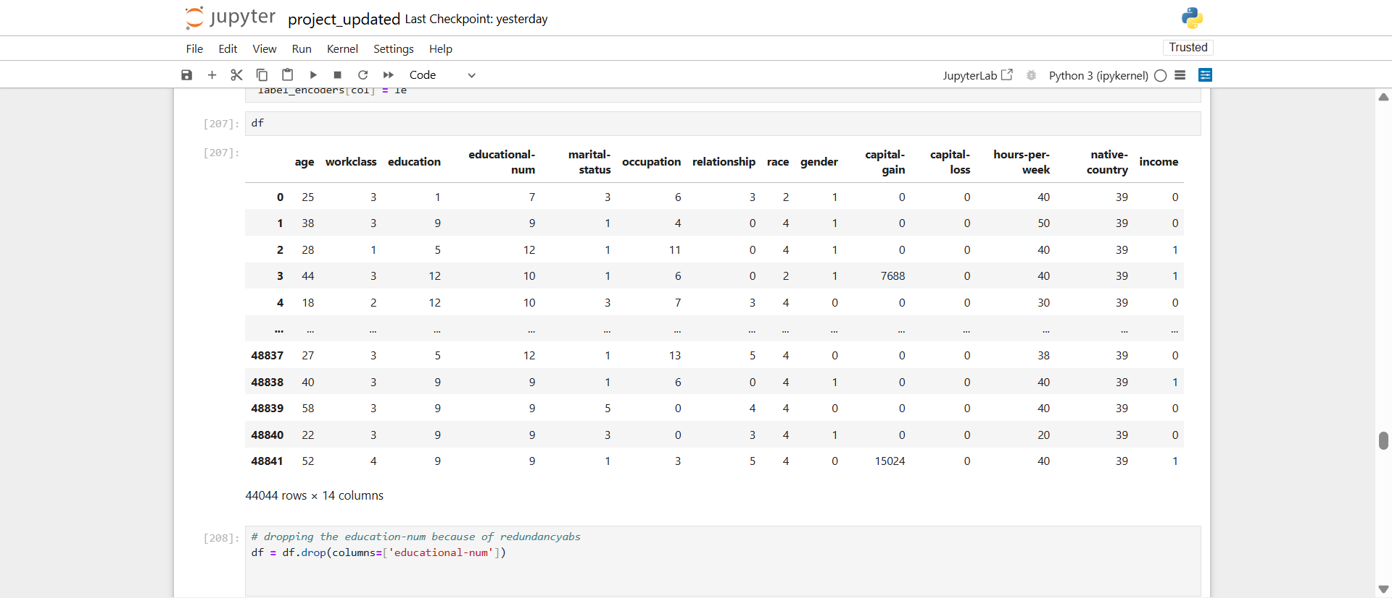

Slide 21
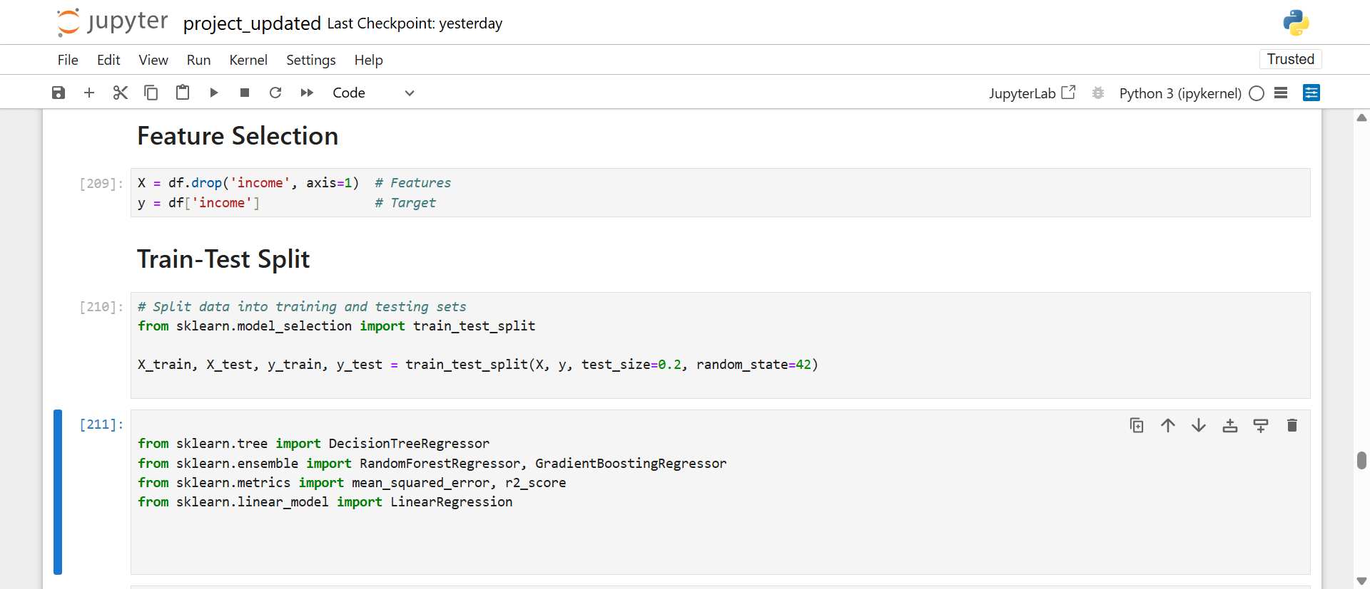
5. Feature selection

Slide 22
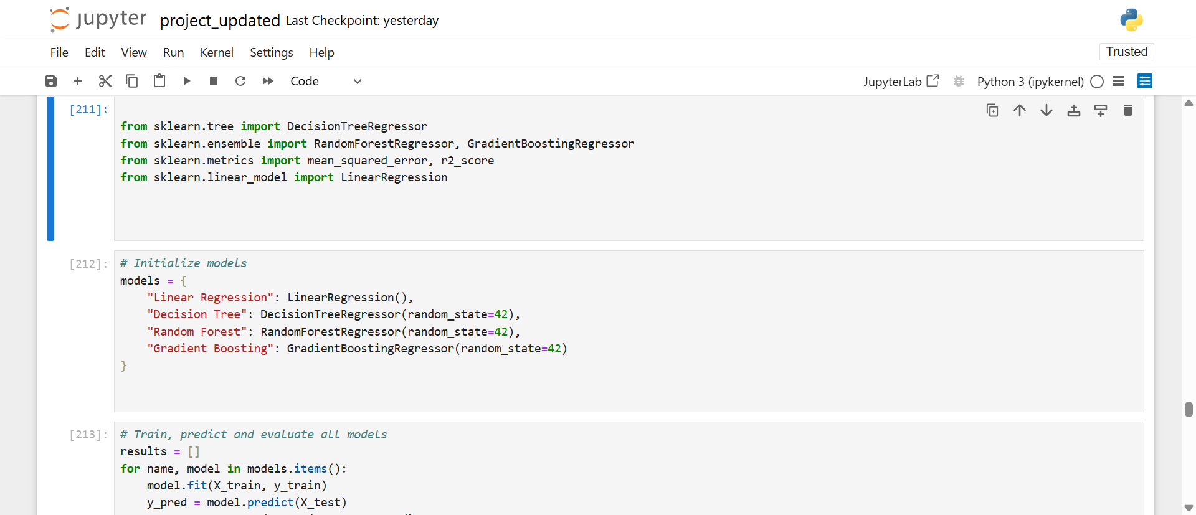
6. Model building

Slide 23
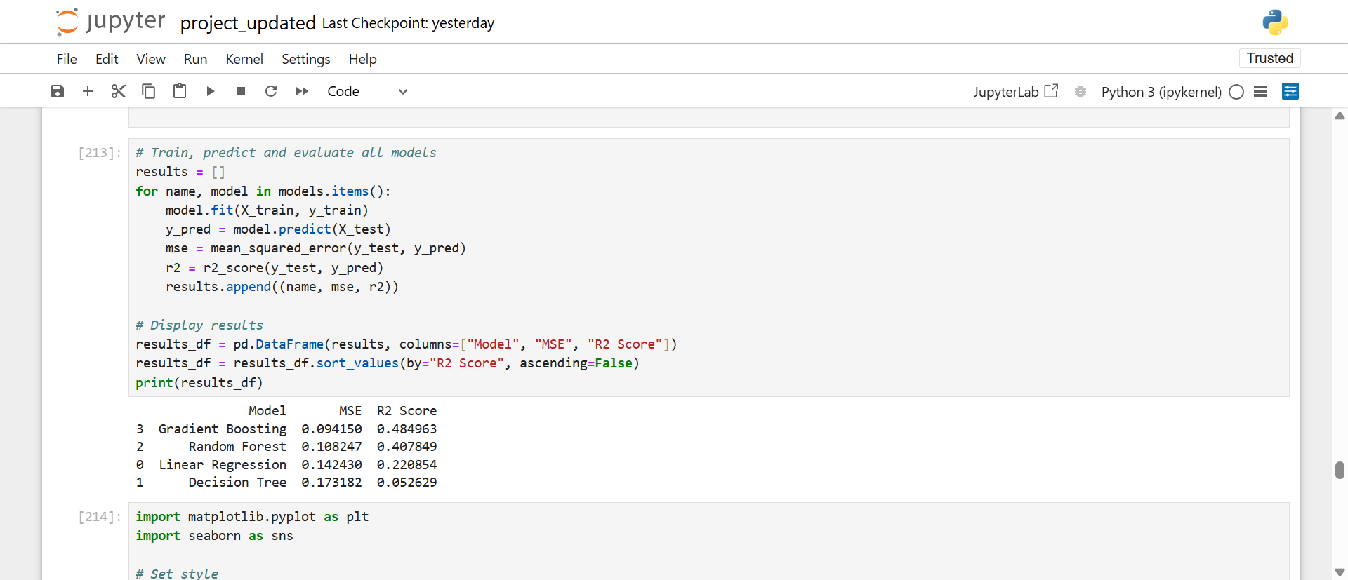

Slide 24
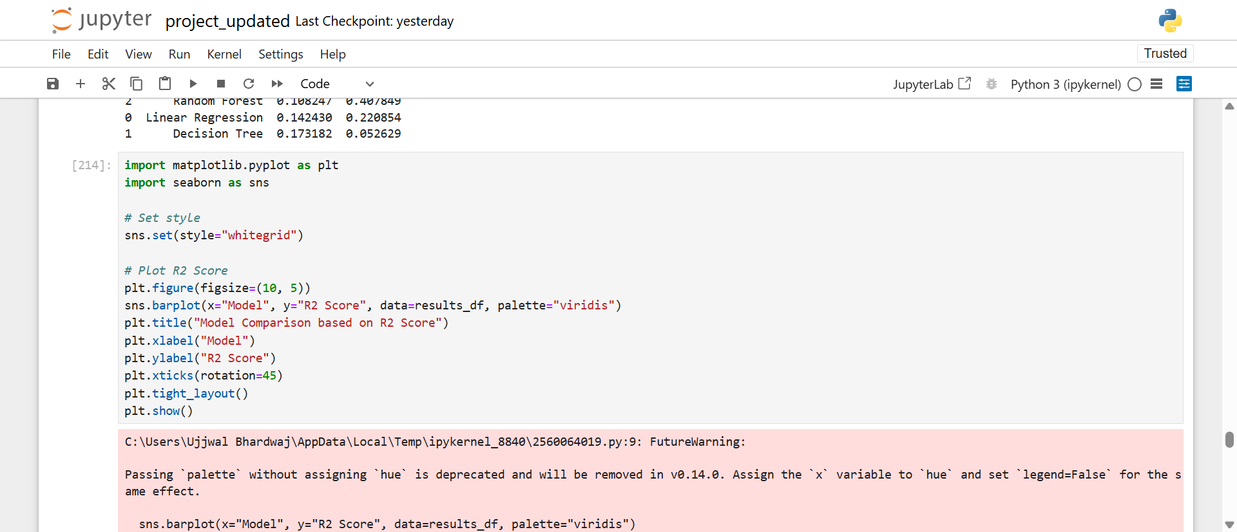
7. Model evaluation

Slide 25
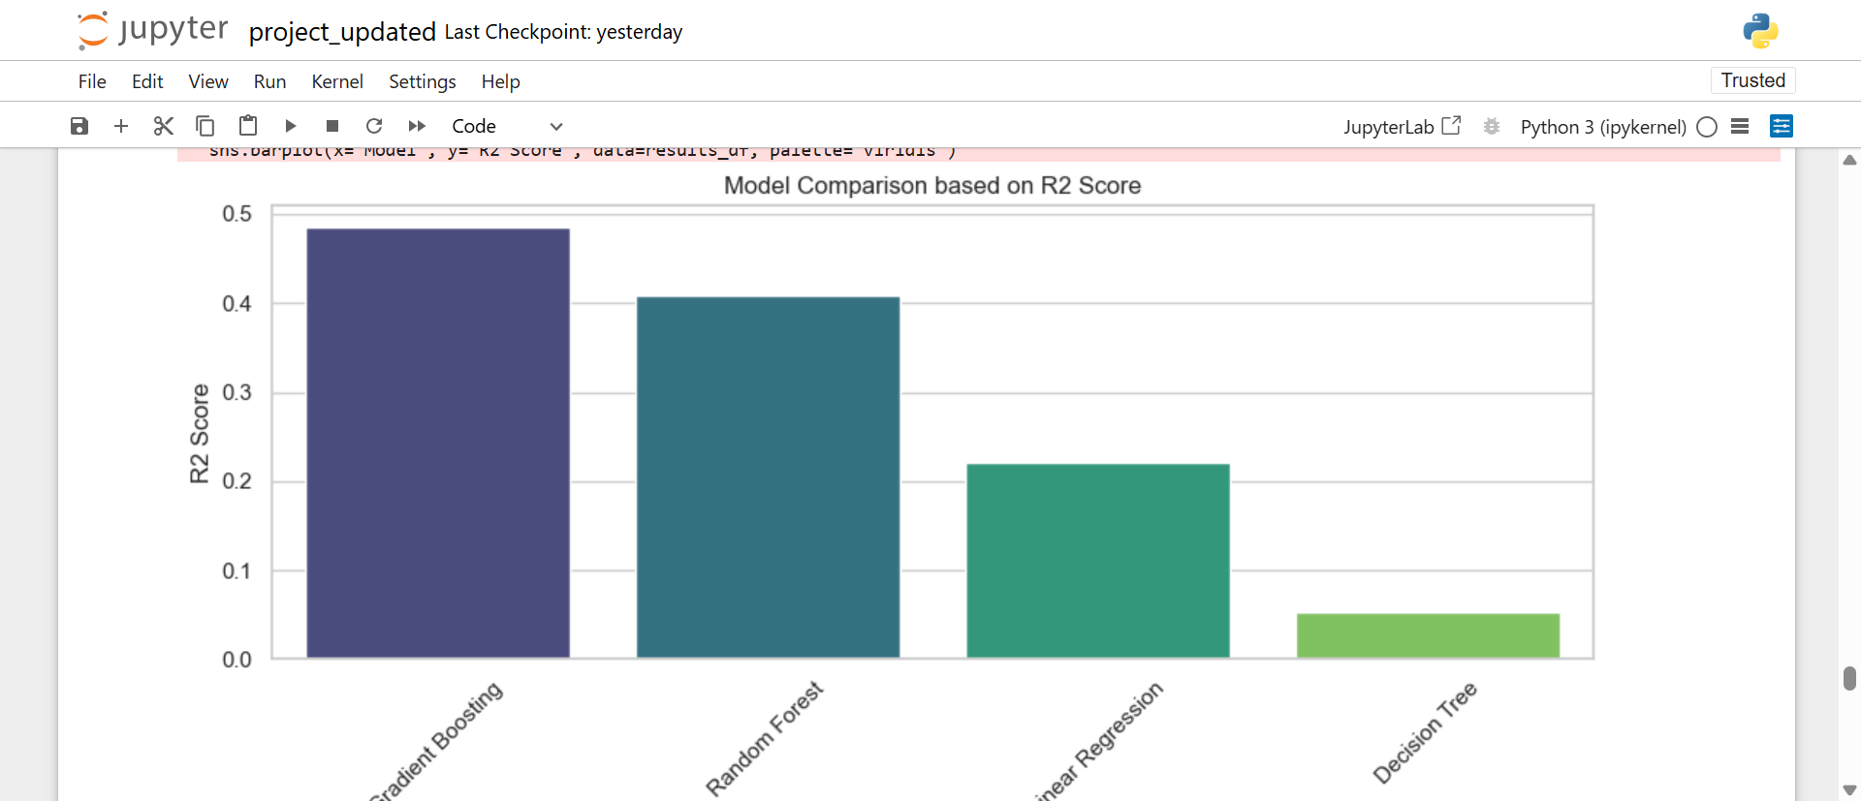
Model comparison based on (r²) score

Slide 26
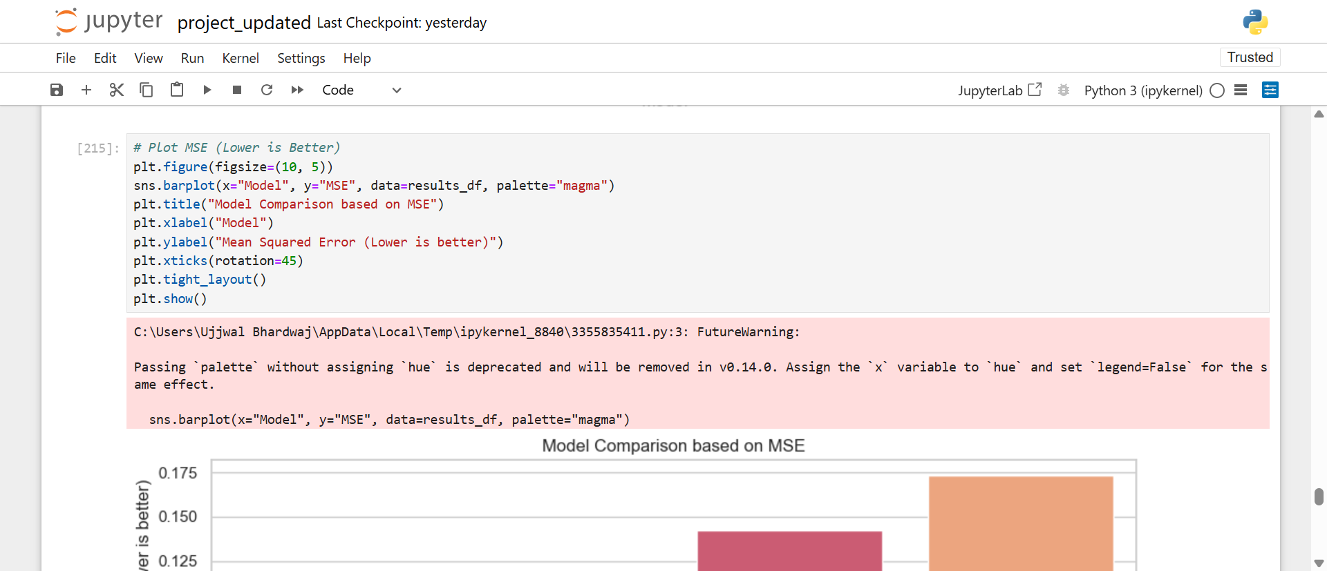

Slide 27
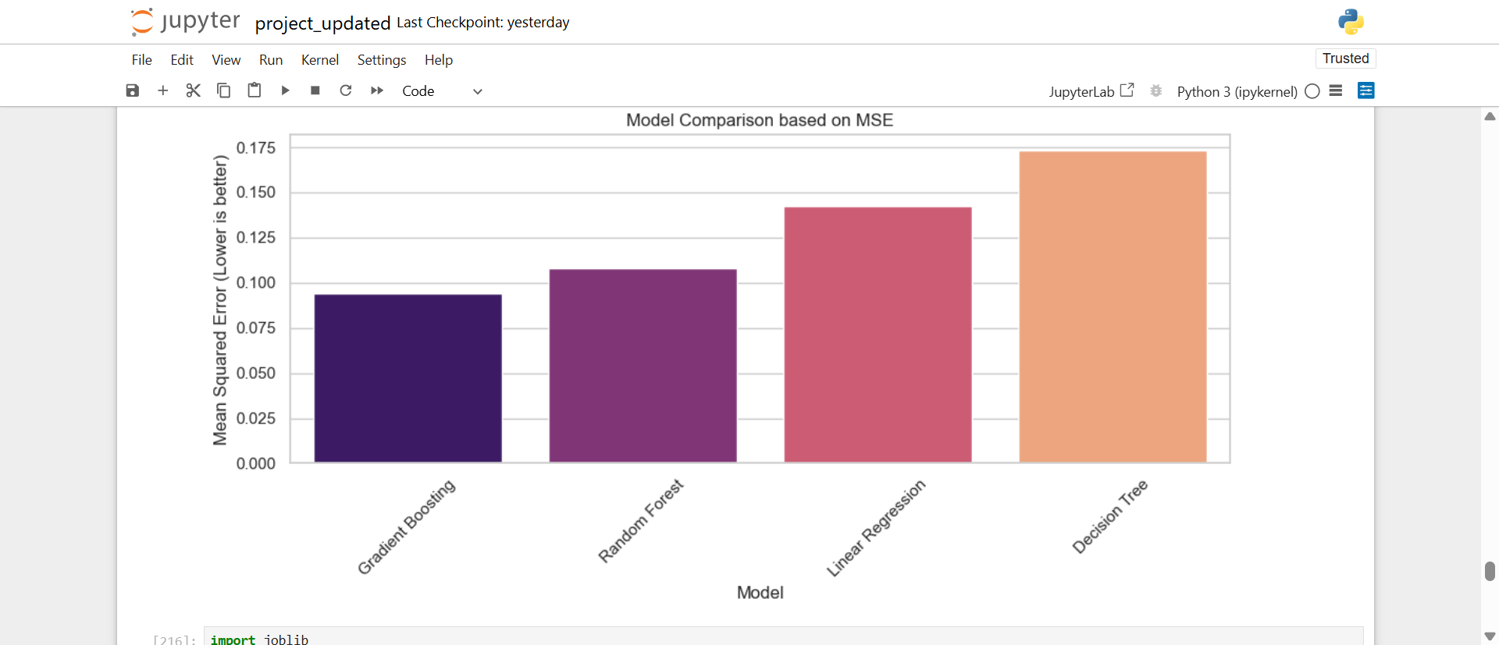
Model comparison based on mse

Slide 28
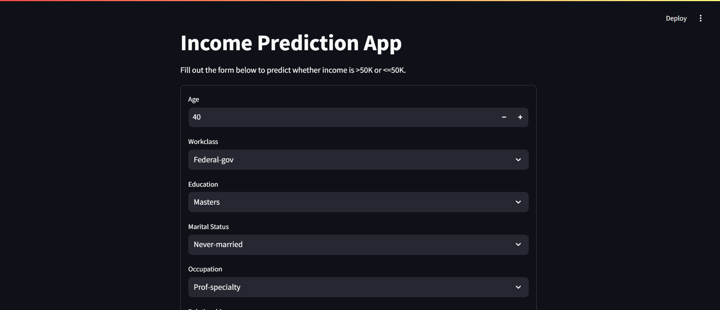
8. deployement

Slide 29
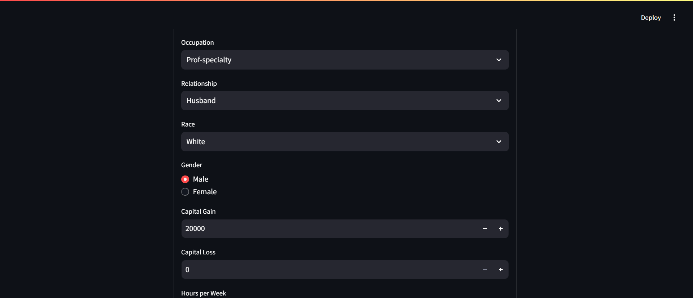

Slide 30
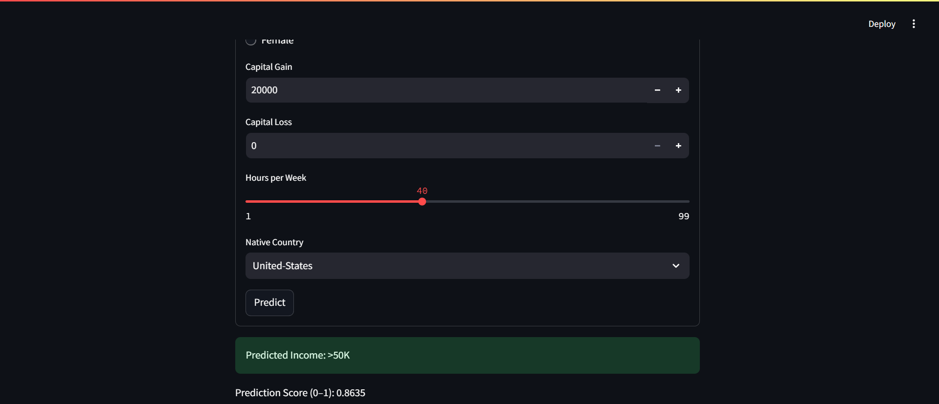

Slide 31
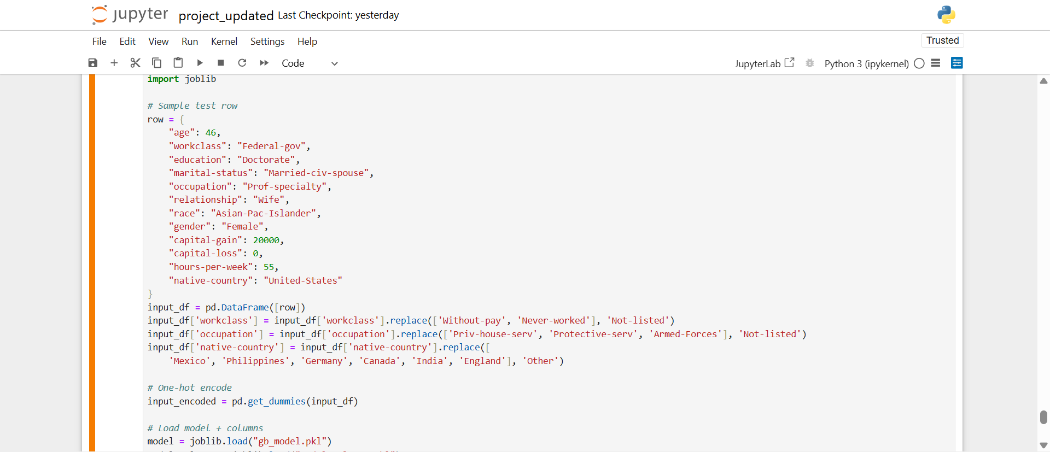
Some sample input

Slide 32
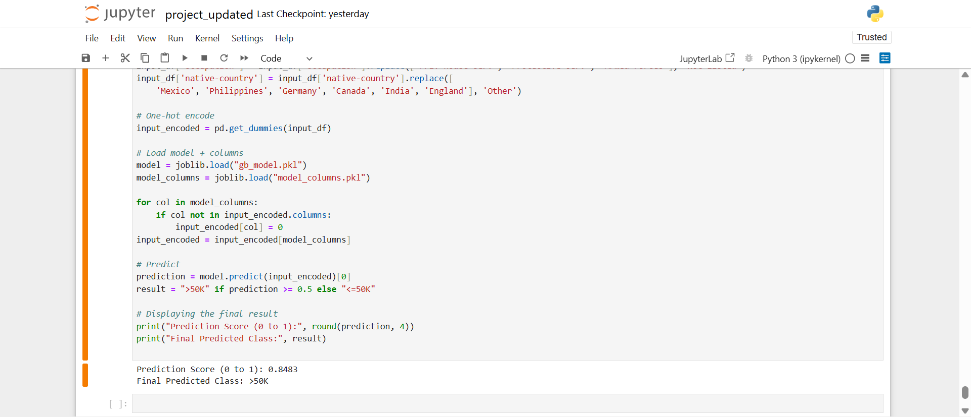

Slide 33
Result

Slide 34
R2 score of gradient boosting best among all

Slide 37
Github link
https://github.com/Maxx-06/Employee-Salary-Prediction

Slide 38
Conclusion
🔚 Conclusion :
We built a machine learning model to predict employee salaries based on key features like experience and education. The Gradient Boost gave the best results with an R² score of ~0.48.
Challenges:
Handling missing data
Encoding categorical variables
Avoiding overfitting
Improvements:
Add more features
Try advanced models
Deploy to cloud for real-time use

Slide 39
Future scope
🔮 Future Scope
Add more features like certifications, company size, and performance rating
Try advanced models like XGBoost or neural networks
Deploy the model using cloud platforms (e.g., Heroku, AWS)
Integrate with HR systems for real-time predictions
Improve UI for better user experience using Streamlit or Flask

Slide 40
References
📚 References :
Python Libraries:
Scikit-learn Documentation
Pandas Documentation
NumPy Documentation
Matplotlib
Seaborn
Streamlit Documentation

Slide 41
THANK YOU

